Slide 1
Chapter 9 Back up

Slide 2
Outline
In this chapter, you will learn
The necessity to backup
An overview of backup work
How to use commands for backup

Slide 3
Why do we need backup and restore
To keep our data in safety
Data can be damaged
By hardware failure
By software failure
OS, Application
By natural dissasters
Integrity, Electricity, Air conditioning, weather disaster
By human errors
Need to come back from the catastrophy

Slide 4
How to backup
Hardware backup
Backup systems, devices, …
Backup policy
2 types of backup strategies
Backup and restore file and directory
Using tar command
Backup and restore file system
Using dump command
Using restore command
Notes:
It is necessary to backup to prevent the loss of data due to several problems such as a physical breakdown, an accidental mistake, and a malicious attack, etc. To operate the system safely, a planned backup should be executed.
Backup enables you to restore data when there is a crash of the system or when a file is accidentally deleted. Backup can be varied from a simple backup such as restore a specific file or directory to a more complex backup such as restore the whole file systems. There 2 types of commands which correspond to each purpose.
• To backup file or directory, use command tar: This command groups a number of files and/or a number of directories in a form called ‘tar’. The file concatenated into one is called an archive file. It is not only used to back up but also to concatenate various files. This command also allows us to compress our archives.
• To backup file system
dump: Command that backs up the entire file system
restore: Command that restores data backed up by ‘dump’ command.

Slide 5
Physical Backup
Backup server
Backup storage
Backup service
Kind
Cold, Warm. Hot
Locate remotely
$$$$$$$$$$$$$$$$$$$$$$$$$$$$$$$$$$$

Slide 6
Data backup
Copy data into safe place
Verify that data can be restored
Be ready to restore

Slide 7
Backup policy
When to backup
Who do the backup
Backup procedure
Backup tools
Restore procedure

Slide 8
Backup types
By Backup objects
Files and directories backup
Hole system backup
By backup methods
Full backup
Incremental backup
Diferential backup
By backup media
Tapes, Disks, Network devices

Slide 9
Restoration
Delivering backup
Back

Slide 10
Backup and restore file and directory
Using ‘tar’ command
(1) # tar cvf /dev/st0 ./homework1
(2) # tar tvf /dev/st0
(3) # tar xvf /dev/st0 ./homework1
(a)# tar cvfz backup.tar.gz file1 file2 file3
(b)# tar tvfz backup.tar.gz
(c)# tar xvfz backup.tar.gz
Notes:
The tar command (abbreviation of Tape Archive) saves and restores the file to the backup destination, specifying a device file such as tape unit or a usual file name.
Usage: tar [option] file_or_directory_of_backup_source
Major options:
c : Write it in the file of the ‘tar’ form.
x : Restore it from the file of the ‘tar’ form.
t : Display the contents of a file list of the ‘tar’ form.
v : Display the message such as the file name while ‘tar’ form command is running.
f : Specify the file name of the ‘tar’ form.
z : Support the ‘tar’ file of the ‘gzip’ compressed format.
(1) Save the subordinate file directory of the ‘homework1’ directory to the tape.
(2) Display the contents of the tape.
(3) Restore the subordinate of the ‘homework1’ directory in the tape.
(4) (a) Bring three files together in one ‘tar’ form, and compress it with ‘gzip’ at the same time.
(b) Display the contents of a ‘tar’ form file compressed with ‘gzip’.
(c) Restore the file from the ‘tar’ form file compressed with ‘gzip’.
The ‘tar’ command of Linux adopts ‘GNU tar (gtar)’ can do more functions:
• The backup destinations can extend over several tapes (multi-volume).
• When creating file from the ‘tar’ file and restoring file from the ‘tar’ file, files can be compressed and decompressed.

Slide 11
Tape operation
(1) #mt -f /dev/nst0 fsf 2
(2) #mt- f /dev/nst0 bsfm 1
(3) #mt -f /dev/st0 rewind
Notes:
mt command can be used to send command to the tape such as rewind or forward to the head position of the tape and display the status of the tape etc.
Usage: mt [-f tape_station] Command [frequency ]
Major options:
f device_name: Specify the device file name of tape unit.
Command [frequency]
fsf n: Forward ‘n’ space(s) of reading position in the specified file.
bsfm n: Backward ‘n’ space(s) of reading position in the specified file.
rewind: Rewind to the head of the tape.
status: Display information about the tape.

Slide 12
Backup and restore file system
How ‘dump’ and ‘restore’ command works?
dump → saves backup copy of file system to tape and disk and save history
restore → get back file system from tape and disk
Notes:
As hard disk is one type of physical components of a computer system, there is a possibility of hard disk failure during operation. Backup and restore file system using dump and restore command enables you to minimize the amount of recovery work at hard disk failure.
The ‘dump’ command copies the complete file system onto the magnetic tape and the disk as well as performs ‘incremental dump’ which is an action that copies only the parts that was changed from the last backup.
The ‘restore’ command restore the file system by the whole.

Slide 13
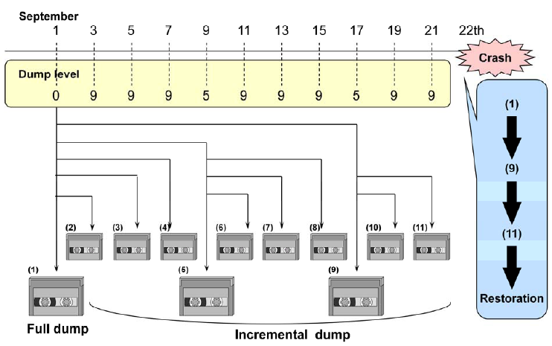
Dump level and generation management
Notes:
The dump command is used with different levels. You will specify dump command with options of level from 0 to 9
At level O, a full back up (copy all the current files in the partition for back up) will be taken, it is called full dump.
Level 1 to 9 is where you use for incremental backup, it is called incremental dump.
Incremental dump means that only the part that has changed between the present back up and the last backup (which has the level smaller than present backup level) will be backed up.If you restore files, you will first restore the latest file has been dumped at level 0, then the lowest level sequentially (Look at the above diagram).
Backup management refers to the task of improving the efficiency of the back up work for the file system such as tape capacity management by doing frequent small number of dumps.
File /etc/dumpdates is where you can look for date and time doing different backups

Slide 14
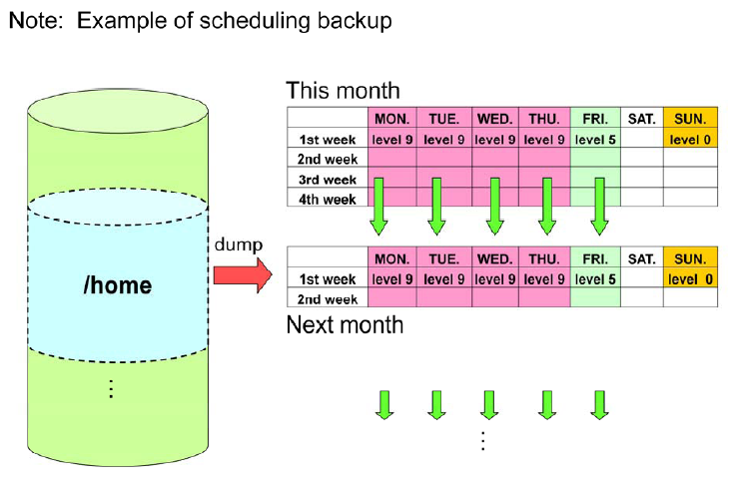
An example backup scheduling
Notes:
When scheduling backup, following points are considered
Update frequency of the file system: Some file systems are not modified frequently such as /usr and /opt, the frequency of backup for this 2 file system could be small like once a month. But /home which user might update it everyday will have a dense everyday backup frequency
Tape management: You should keep lowest level back up files when doing incremental backup which saves time. Management task for this is more complex

Slide 15
Using ‘dump’ command
(1) Shift to single user
# init 1
(2) Check unmount and file system
# umount /home; fsck -aV /dev/hda6
(3) Saves it to the tape
(a)# dump 0uf /dev/st0 /dev/hda6
(b)# dump 5uf /dev/st0 /dev/hda6
# dump 5uf /backup/dumpdata /dev/hda6
(c)# dump 9uf /dev/nst0 /dev/hda6
# dump 9uf /dev/nst0 /dev/hda5
# dump 9uf /dev/nst0 /dev/hda1
Notes:
The dump command allows to copy entire file system to backup device. Before doing it, it is recommended to login to single user mode, disconnect the driver to backup. To ensure that the backup process will be running correctly, the file system has to be verified by the command fsck. Then the backup process can be started. The contents of the file systems will be copied to external tape device
Switch to single mode so others cannot access files during backup
Demount the target so you can check for file system using fsck –aV
Back up each partition using dump
Full backup for /dev/hda6
Incremental backup level 5
Incremental backup level 9. The device /dev/nst0 will store 3 datas in one tape unit. “n” means no rewinding.
dump [option] file system of backup source
Major option: 0-9 backup level (0: full backup, 1-9: incremental backup)
u: Saving log back up in /etc/dumpdates
f: Specify the destination file name( such as device name of tape unit)

Slide 16
Using ‘restore’ command
Display all dump files on the tape
# restore tf /dev/st0
Restore all dump files to current directory
# restore rf /dev/st0
(3) Restore specified file and directory
# restore cf /dev/st0 .x/usr00
(4) Restore file interactively
# restore if /dev/st0
Notes:
When the system need to be restore, we can use the command restore to do it. The command allows us to view the content of the backup, to restore all of files included in the backup to the current directory, or specify exactly which files to restore. The option if is used to specify interactive restoration.
Restore [option]
Options
r: Restore all dump files to the current directory
x: Restore only specified file and directory to the current directory
t: Display whether the specified file name on tape
i: Execute restore interactively (question and answer)
v: Display restore file and directory
f: Specify the archive file name (device name of tape,etc ) to be restore
r/x/t/i are mutually exclusive, i.e they cannot be specified at the same time

